Slide 1
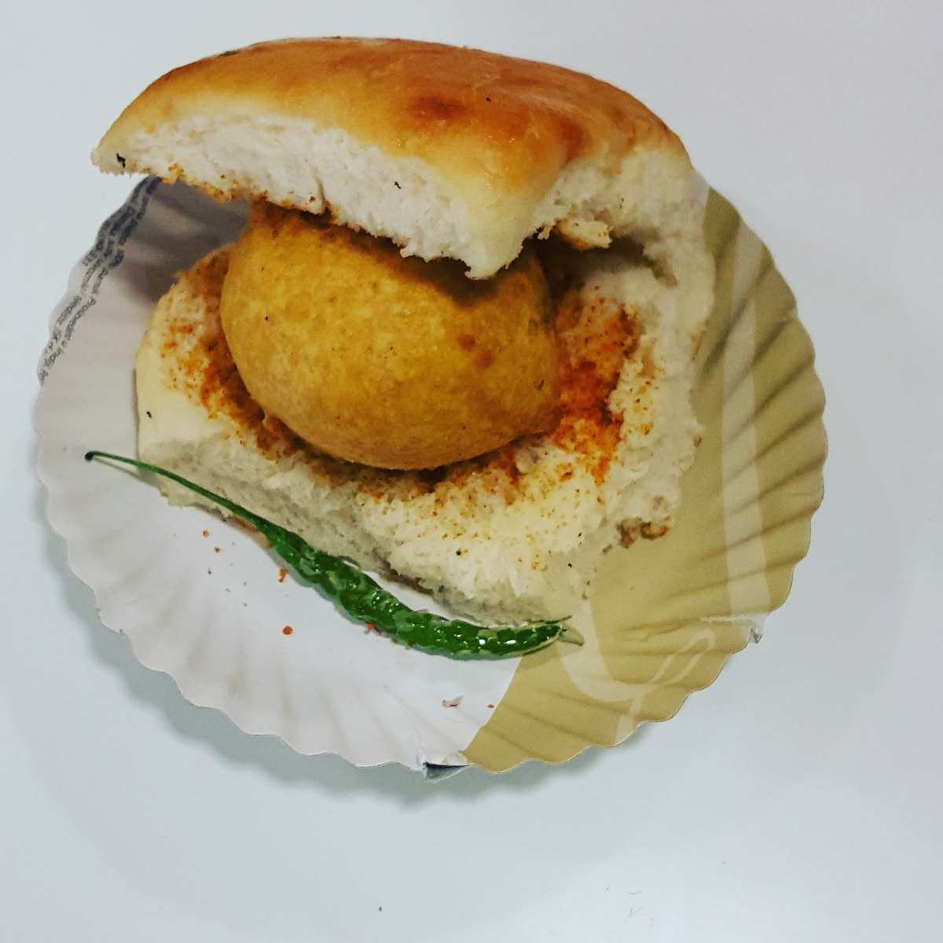
Vada Pav
Bhushan kulkarni

Slide 2
Agenda
1) Introduction
2)Problem Statement.
3)Solution.
4)Impact.

Slide 3
Introduction
The dish is believed to have been invented in 1966 by a Mumbaikar, Ashok Vaidya, who opened the first vada pav stall opposite the Dadar train station, through which hundreds of thousands of workers – often in need of a quick, inexpensive snack – passed every day on their way to the textile mills in suburbs
Vada pav, alternatively spelt wada pao, ( listen) is a vegetarian fast food dish native to the state of Maharashtra. The dish consists of a deep fried potato dumpling placed inside a bread bun (pav) sliced almost in half through the middle. It is generally accompanied with one or more chutneys and a green chili pepper.
Vada pav witnessed a meteoric rise in popularity through '70s and '80s when it was seen as the snack of the working class. It was cheap, easy-to-make and convenient to eat;

Slide 4
Problem statement & data Source
The problem statements provide the data that a man wants to open Wada pav shop in Shivaji nagar pune. Where 4 shops are already present in the nearby location without any prior data and strategy to take over the clients of other 4 shops.

Slide 5
Objective and methodology
Understanding the customer taste and pattern
Route map for future growth
Use Good quality of material like, Gram floor, oil
Analyse the supply and demand from local survey which is not satisfy by competitor

Slide 6
Solution Description
Survey of local area shops and Customer taste
2) introductory offer, Special price(less price ) to attract the customers at least for 2-3 days
3) Special Discount on bulk orders.
4) Online as well as home delivery options.
5) Good Hygiene and drinking water arrangements
6) Seating Arrangements
7) Good taste and different variety
8) Branding using social media

Slide 7
Impact
Studying survey & data from local people Make a road map for Growing business
Growing business month wise by increasing sales

